Slide 1

RAINFALL PREDICTION
Project Supervisor: Dr . Nancy Noella, M.E., Ph.D.
Name of the Student: Karri Vishnu Sai Rama Reddy.
Register Number: 40110552.

Slide 2
Presentation Outline
Course Certificate
Introduction
Objectives
System Architecture / Ideation Map
Module Implementation
Application Snapshots
Results and Discussions
Conclusion & Future work
References

Slide 3
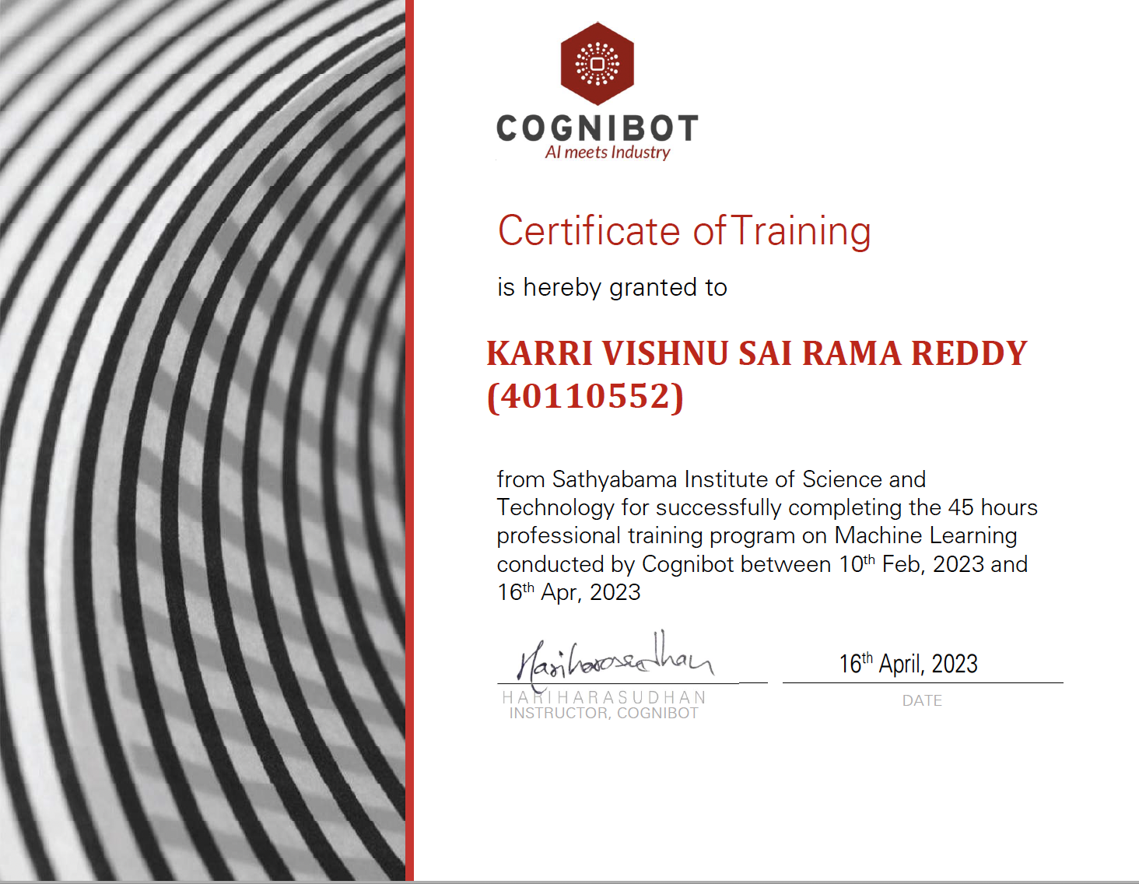
Course Certificate

Slide 4

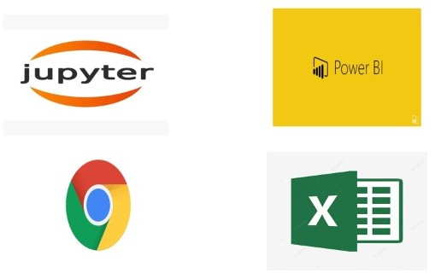
APL’s used

Slide 5
Introduction
Rainfall Prediction is the application of science and technology to predict the amount of rainfall over a region. It is important to exactly determine the rainfall for effective use of water resources, crop productivity and pre-planning of water structures.
Our goal is to predict rainfall in Australia using attributes displayed in the dataset
We have shown an overview of Australia based
on various places temperature , humidity etc.To predict if there is a rainfall tomorrow or not.

Slide 6
Introduction cont...
Problem Statement :
The major challenge in Rainfall prediction is it’s prediction .There are instruments available which can predict rainfall .This project introduces current supervised learning model which are based on machine learning .
Rainfall is major issue across the world as it effects all the major factors on which human being is dependent .
In current unpredictable and accurate rainfall prediction is challenging task.

Slide 7
Objectives
To develop machine learning model that predicts Rainfall using Random Forest Classifier.
To determine significant factors based on dataset which may lead to Rainfall.
To analyze features specification method and understand this working principle.

Slide 8
Objectives cont…
Scope :
Developing a project that effectively shows the prediction of rainfall.
Implementing it on the computer system.
The code has been written in python programming language using Jupiter notebook.
The experiment and all the modules building are done based on python libraries.

Slide 9
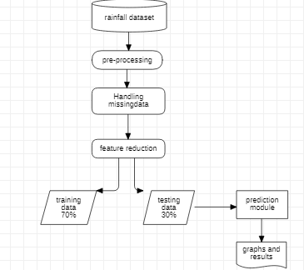
System Architecture / Ideation Map

Slide 10
Project Implementation
We have designed our project by using Jupiter notebook.
We collected data from Rainfall prediction data set of Australia called Kaggle.
Requirements:
Software:- Jupyter notebook ,Google, Excel.
Hardware:- PC or Desktop.

Slide 11
Project Implementation cont…
Construction:-
- For construction of successful l project we
have to collect good data.
- For our project we have collected our data
set from data source called Kaggle.
- After collecting the data set we have
imported it to Jupyter notebook.
- And then completed the project
successfully.

Slide 12
Project Implementation cont…
Analysis:-
- Now we have collected our data from data
source , we need to examine the quality of
data.
- The easiest way to check the quality of data
is to importing the data to jupyter notebook and by running Data Filtration methods.

Slide 13
ABOUT DATASET
Context :
Predict next-day rain by training classification models on the target variable RainTomorrow.
Content :
This dataset contains about 10 years of daily weather observations from many locations across Australia.
RainTomorrow is the target variable to predict. It means -- did it rain the next day, Yes or No? This column is Yes if the rain for that day was 1mm or more.

Slide 14
Methodology
Our Project is carried out to achieve a set of goals with some conditions keeping in mind that it is easy to understand.
For easy understandings we have used python programming language which is implemented in our project.
We have done our project in Jupyter notebook by implementing the above details in the system on basis of machine learning.

Slide 15
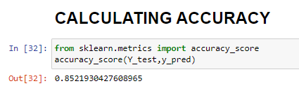
Results and Discussion
This is an individual project given to all students who were selected for HCL.
After completing my coding . My best part is that I got accuracy of 85%.

Slide 16
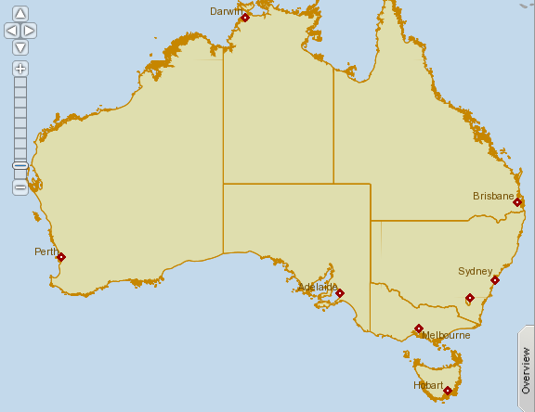
Results and Discussion cont…
Map view

Slide 17
Conclusion
By using jupyter notebook the Prediction of Raingfall for Rainfall data set is implemented.
We have achieved the project upto our limit.
We are unable to do the project on a certain continent because it requires meta data which is beyond our scope.

Slide 18
Source and Acknowledgement
Observations were drawn from numerous weather stations. The daily observations are available from http://www.bom.gov.au/climate/data. An example of latest weather observations in Canberra: http://www.bom.gov.au/climate/dwo/IDCJDW2801.latest.shtml
Definitions adapted from http://www.bom.gov.au/climate/dwo/IDCJDW0000.shtml Data source: http://www.bom.gov.au/climate/dwo/ and http://www.bom.gov.au/climate/data.
Copyright Commonwealth of Australia 2010, Bureau of Meteorology.

Slide 19
References
[1] | HCL Machine Learning Project from Sankaran Vaidyanathan Sir.
[2] | Data Reference from: Kaggle datasets download -d jsphyg/weather-dataset-rattle-package
[3] | Machine Learning coding reference from: sklearn.impute.SimpleImputer and http://www.bom.gov.au/climate/data.
[4] | On collage I learned some basic fundamentals of machine learning from Sathyabama mam teachings and my guide Cruz Antony Sir Helped me a lot during this project.

